Slide 1
Initial Management of
Critical Patients–Part 1

Slide 2
Generic Approach
1-Danger? | Safety? Support? Stability?
2-Data | Point-of-care information
3-Diagnosis? | Time-sensitive diagnoses?
4-Decisions | Further investigations/treatments?
5-Disposition | Verbal/written communication

Slide 3
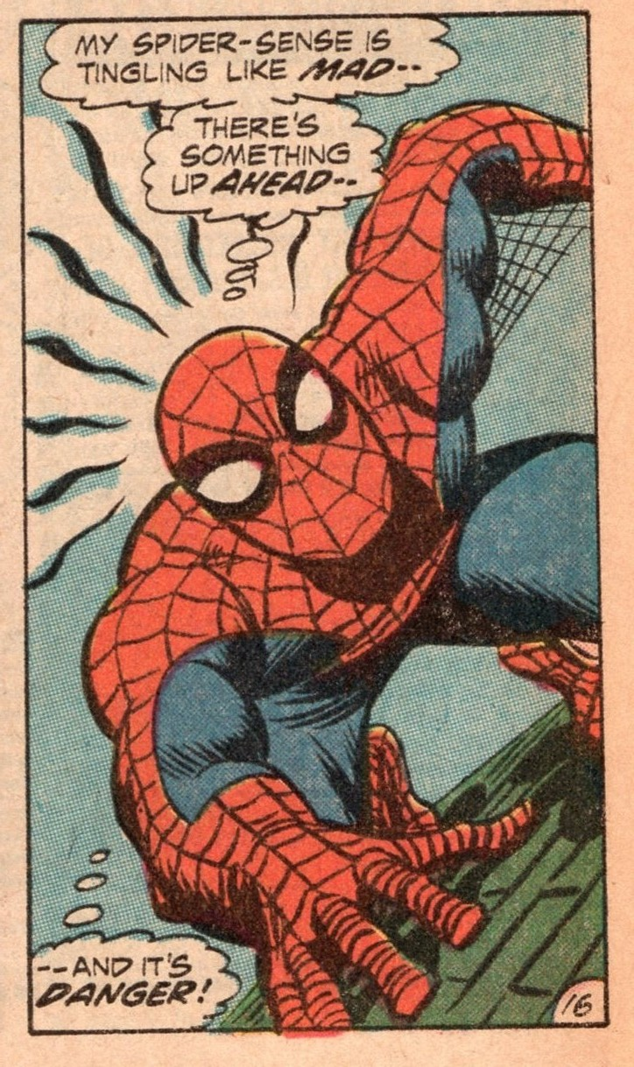
Danger?
Patient’s appearance
Vital signs
Circumstances
Notes:
Abnormal vital signs
Circumstances (e.g. traffic accident resulting in deaths)
Patient’s appearance (diaphoresis, agitation)

Slide 4
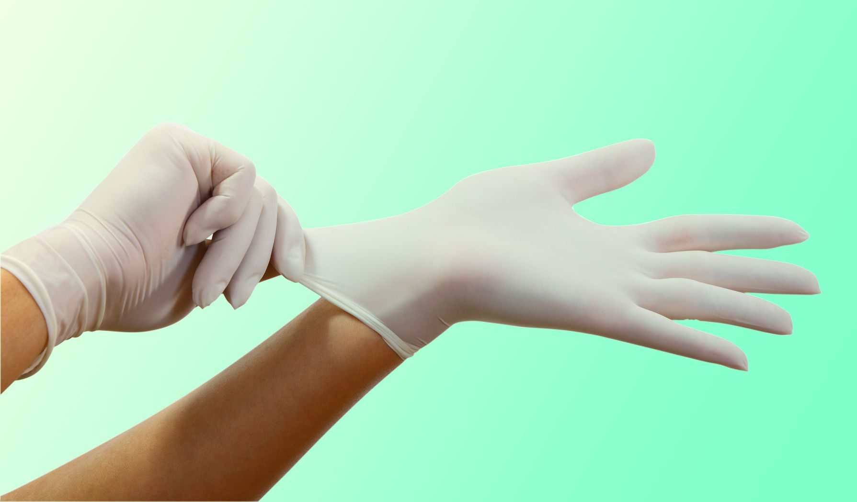
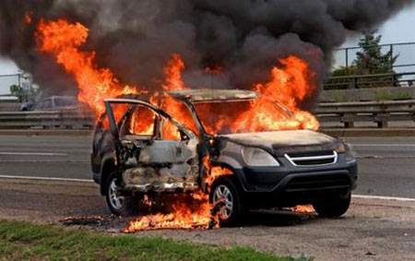
Safety

Slide 5
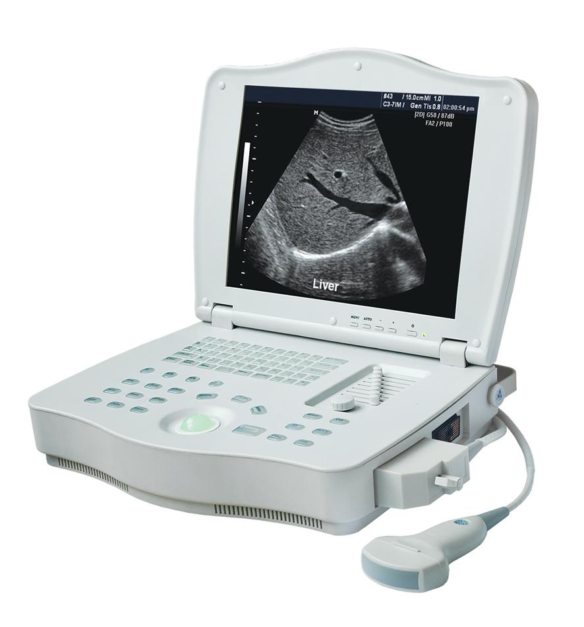

Support

Slide 6


Team: why?
Notes:
Varför krävs flera vårdpersonal när en patient plötsligt blir svårt sjuk? DELTAGARNA FÅR SVARA
1-Många bedömningar och åtgärder behöver genomföras inom ett kort tidsram, och då krävs flera händer.
2-Som grupp är vi klokare än som individer, och då är det bra för patienten om fler vårdpersonal bidrar med tankar och förslag.

Slide 7


Team: challenges?
Notes:
Varför är effektivt teamarbete svårt? DELTAGARNA FÅR SVARA
1-Alla bör inte göra samma uppgifter, utan uppgifterna behöver effektivt omfördelas bland teammedlemmar. Det krävs någon sorts organisation.
2-Teammedlemmar behöver dessutom effektivt kommunicera med varandra för att kunna dela information med varandra och anpassa sig till en utvecklande situation.

Slide 8
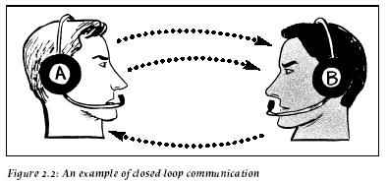
Two Communication Formats
S | Situation
B | Background
A | Assessment
R | Recommendation

Slide 9
Sign-In
Situation | Team Patient
Background | Background Current
Assessment | Potential diagnoses? Potential measures?
Recommendation | Roles—extra personnel? Questions / suggestions?

Slide 10
Weight
< 1 year | (month / 2) + 4
1-4 years | (years x 2) + 10
5-14 years | years x 4

Slide 11
Closed-loop
A: “B, count the respiratory rate”
B: “I’ll count the respiratory rate”
A: “Thanks”

Slide 12
Stability: ABCDE
Purpose
Reduce morbidity through early measures
How do you treat when you don’t know the Dx?
Method
Find problems that can be treated directly
Recognize syndromes that can be treated early

Slide 13

Syndromes
Anaphylaxis
Sepsis
Opioid toxidrome

Slide 14
Generic ABCDE
C | Pulse, BP? Heart rate? Rhythm? (2 lead)
D | ACVPU? Eyes? Moving hands/feet? Glucose?
E | Front Back Temperature?
O | Cardiac arrest?
A | Head trauma? Airway sounds? Oral cavity?
B | SpO₂? Resp rate? Lung auscultation? Chest wall?
Notes:
ACVPU stands for
Alert
Confused
Verbal
Pain
Unresponsive

Slide 15
 | Assessments | Interventions
O | Safety? Support? Special situation? | PPE, relocate Request personnel/equipment CPR, pressure to catastrophic bleed
A | Head trauma? Airway sounds? Oral cavity? | Manual stabilization of the C-spine Upper Airway Interventions Suction, lateral decubitus, forceps
A* | Head trauma? EtCO2? Tube? | Manual stabilization of the C-spine Extubate if no EtCO2 Suction
*: Already intubated
Notes:
So let’s now go through a proposed generic ABCDE.
There is a step before A. This is the O step on this slide, where O stands for Overview. The purpose of O is to prevent an escalation of acuity.
During the Overview step, there are three assessments:
First assessment: Safety? The potential interventions to consider are what PPE to done and whether the working environment is safe for patient and personnel
Second assessemnt: Support? The potential interventions to consider are requesting additional personnel and requesting additional equipment
Third assessment: Special Situation? Cardiac arrest should be identified during the overview, and advanced cardiopulmonary resuscitation initiated. Catastrophic bleeding should be stopped using pressure or tourniquet before proceeding to the next step.
The next step is A for Airway. The purpose of A is to stabilize the cervical spine if it is potentially unstable, and to ensure patency between the pharynx and carina.
During A, there are three assessments:
First assessment: Head trauma? The potential intervention to consider is manual stabilization of the cervical spine.
Second assessment: listen to the airway sounds. The potential interventions to consider are airway interventions which are covered in the next slide.
Third assessment: inspect the oral cavity. The potential interventions are suction, lateral decubitus and the use of forceps to remove liquids or loose solids from the oral cavity
If the patient is already intubated, there are still three assessments during A:
First assessment: Head trauma? The potential intervention to consider is manual stabilization of the cervical spine.
Second assessment: Measuring the End-tidal CO2. If there is no end-tidal CO2, the assumption should be that the tube is not in the right place and the patient should be extubated.
Third assessment: Inspecting the tube. If it contains liquid, the tube should be suctioned

Slide 16
 | Assessments | Interventions
B | SpO2%? Resp rate? Lung auscultation? Chest wall? | ≥ 10 L O₂ via mask Ventilate via mask Seal open chest
C | Pulses +/- BP? Heart rate? Rhythm? (2-lead EKG) | Crystalloid 10 ml/kg IV/IO Adrenalin IM External pacing
Notes:
The next step is B which stands for Breathing. The purpose of B is to ensure oxygen delivery to the blood and removal of CO2 from the blood.
During B, there are four assessments:
First assessment: what is the SpO2? The potential intervention to consider is the administration of supplemental oxygen via mask
Second assessment: what is the respiratory rate? The potential intervention to consider is ventilating the patient via mask, either with a one-person or two-person technique
Third assessment: lung auscultation. There is no directly linked potential intervention. Wheezing can be caused by an asthma or COPD exacerbation, but also by heart failure. The information acquired during auscultation provides data to recognize certain poisoned arrow patterns.
Fourth assessment: chest wall inspection. If there is a hole in the chest wall, the intervention is to seal the hole
The next step is C for Circulation. The purpose of C is to ensure brain perfusion so that oxygen and glucose can be delivered to the neurons.
During C, there are three assessments
First assessment: presence of the radial or femoral pulse and ideally obtaining a blood pressure. If the pulse is thready or absent or the blood pressure is low, the intervention consists in obtaining intravenous or intraosseous access and administering a bolus of crystalloid, 500 ml for an adult and 10 ml/kg for a child. Once more information is obtained, it will be clearer whether the patient in is shock, and what the cause of the shock is. Then interventions targeted to the cause can be implemented, e.g. giving blood for hemorrhagic shock, given thrombolysis for massive pulmonary embolism. But giving an initial bolus of fluid can be justified.
Second assessment: measuring the heart rate. If the heart rate is really low, it is reasonable to give adrenalin intramuscular instead of atropine, and if the heart rate is really-really low, then the acute initial intervention is external pacing.
Third assessment: heart rhythm. Here, all you need is a two-lead EKG to determine whether the heart rate is regular or not, and whether the QRS complexes are wide or narrow. This information allows you to categorize tachycardias.

Slide 17
 | Assessments | Interventions
D | AVPU, severe agitation Eye examination Moving hands/feet Glucose | Diazepam 5 mg IV Midazolam 5 mg IM Glucose 30 ml 300 mg/ml IV Glucagon IM 1 mg IM
E | Body’s front side* Body’s back side* Temperature? | Pelvic girdle, limb splints Log-roll, immobilize spine Treat/prevent hypo/hyperTh
*-Adapt to circumstances
Notes:
The next step is D which stands for Disability. The purpose of D is to rule out hypoglycemia and detect focal neurological deficits.
During D, there are four assessments:
First assessment: degree of alertness according to AVPU. AVPU stands for Alert-Verbal-Pain-Unconscious.
Second assessment: looking at the eyes for pupillary size and asymmetry, conjugated eye deviation, abnormal movements such as nystagmus or roving eye movements.
Third assessment: examining the gross motor function in the hands and feet. If the patient is not moving these spontaneously, ask the patient to move them. If the patient is unconscious, apply a painful stimulus to the nailbeds and observe the response. This allows for the detection of focal neurological deficits.
Fourth assessment: measuring capillary or plasma glucose.
In terms of interventions during D, they mainly boil down to giving benzodiazepines in the presence of seizure or severe agitation that hampers assessment and treatment, and given glucose or glucagon in the setting of hypoglycemia.
The final step of the ABCE is E for Exposure. The purpose of E is to detect infection/trauma and to detect or prevent hypo and hyperthermia.
During E, there are three assessments
First assessment: inspecting the body’s front side, looking at the skin, looking for signs of trauma or inflammation. What is appropriate under E will depend on the circumstances. For example, it is appropriate to look for petechiae and sources of infection in the setting of suspected sepsis; it is appropriate to assess pelvic ring stability and the femurs in trauma, to perform a peripheral neurovascular examination in limb trauma. Assessing the stability of the pelvic ring in an elderly patient presenting with dyspnea in the absence of known trauma is of dubious value.
Second assessment: inspecting the body’s back side. If spinal injury is suspected, this is done by log-rolling the patient. Palpating the spine is of dubious value in unconscious patients.
Third assessment: checking the patient’s temperature.
The associated interventions will depend on the findings.

Slide 18

“ABCDE 34343”

Slide 19
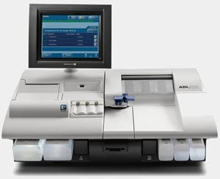
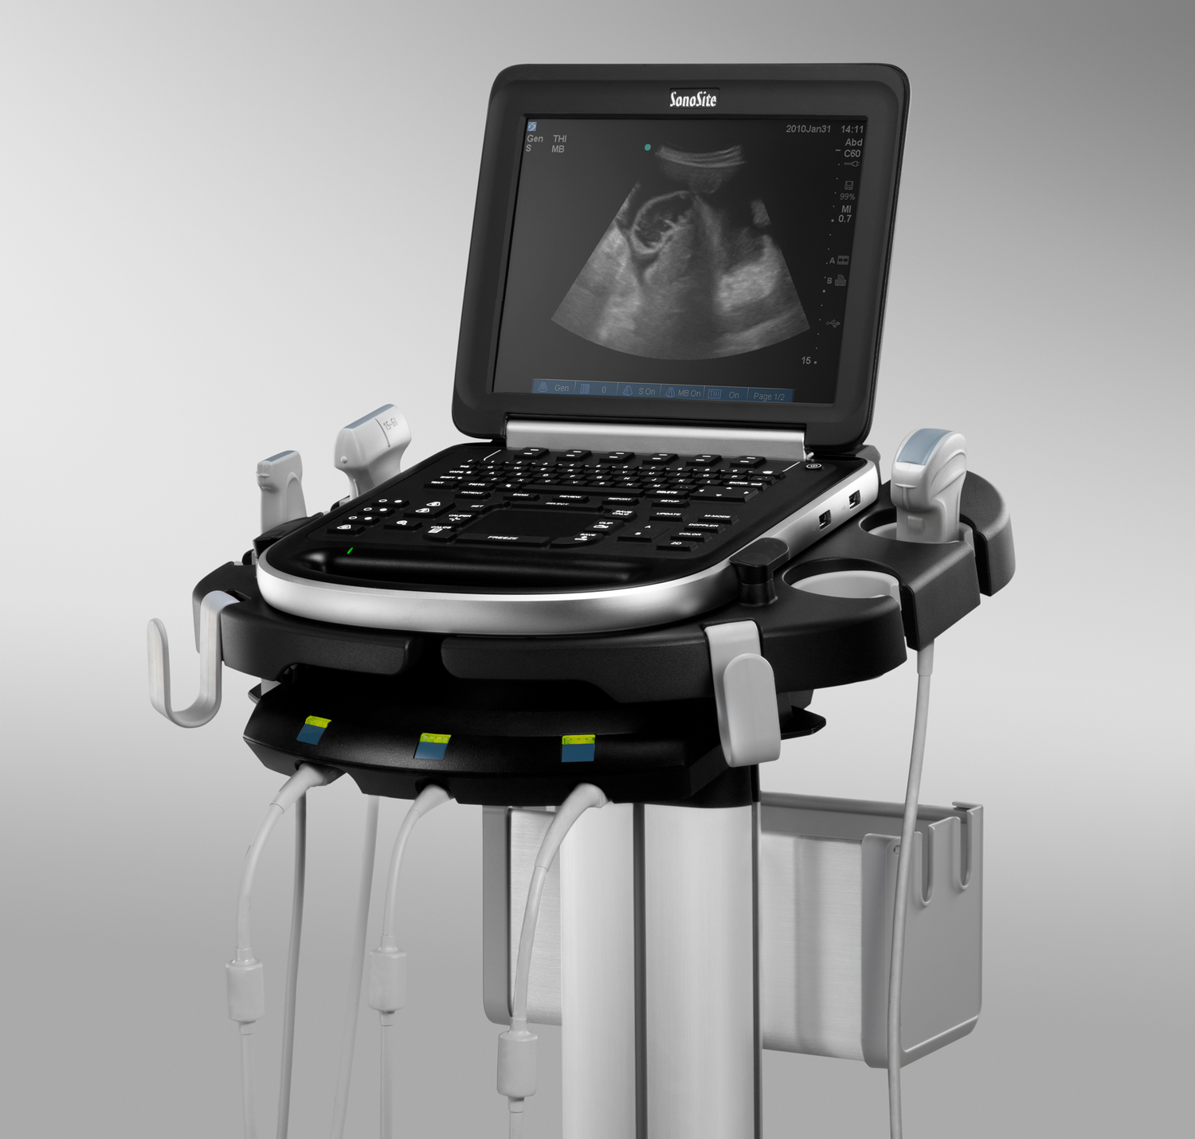
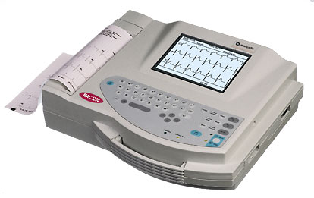
ABCDE+

Slide 20
Syndrome Management
Manage as soon as recognized
Syndrome 1
Syncope
Swollen tongue
Wheezing
Syndrome 2
Trauma
Unilateral absent breath sounds
No radial pulse

Slide 21
Sign-Out
– | Main condition
What? | Further care
Where? | Ward, X-ray, Surgery
Who? | Physician taking over
How? | Transport: personnel/equip.
+ | Opinions / suggestions?

Slide 22
Sign-Over
S | Suspected condition Key findings
b | Provided if asked
a | Provided if asked
r | Provided if asked

Slide 23
Sequential
Simultaneous
A
A
B
C
B
C
D
E
Mixture
Notes:
This slide introduces a dichotomy between “Sequential Resuscitation” and “Simultaneous Resuscitation”
Sequential Resuscitation is carried out when:
1-The patient is actually not that critical; most priority one patients are not on death’s door when they arrive in the ED. It is OK to go sequentially from A through E and no large team of health care personnel is required. You can usually get by with one physician doing A-E at the bedside, one nurse putting in IVs and drawing blood tests and giving medications, and one nursing assistant measuring vitals, taking EKG, putting in Foley etc.
OR
2-When you have few personnel, you need to do things sequentially. Think about ATLS-courses where the scenario is always: “You are working in a rural hospital with few staff.” If you are one physician and one nurse, you can’t do everything at once, you have to do things sequentially and start with A.
Simultaneous Resuscitation is carried out when:
1-Patient is critical
AND
2-Sufficient personnel

Slide 24
4 Key Roles
Fluids
Vitals
Ultra-
sound
Team-Leader
Scribe
forward
Notes:
The “Team-Leader” role is usually carried out by a physician. The tasks are the following:
1-Running the Sign-In and getting the team up and running
2-Carrying out a sequential ABCDE at the bedside
3-Performing ultrasound as needed, and even procedures bedside as needed (e.g. arterial blood gas)
4-Recognizing the syndrome(s) and ordering appropriate treatment
5-Running the Sign-Out including plan for further management

Slide 25
Sign-In
Pelvic binder?
ABCDE
Ultrasound? Procedures?
Syndrome management
Sign-Out & Sign-Over
Ultra-
sound
Team-Leader
back
Notes:
The “Team-Leader” role is usually carried out by a physician. The tasks are the following:
1-Running the Sign-In and getting the team up and running
2-Carrying out a sequential ABCDE at the bedside
3-Performing ultrasound as needed, and even procedures bedside as needed (e.g. arterial blood gas)
4-Recognizing the syndrome(s) and ordering appropriate treatment
5-Running the Sign-Out including plan for further management

Slide 26
Rapid infuser?
PVC? IO?
Blood tests?
Crystalloids? Blood?
Medications?
Infuser
IV-Cart
Fluids
back
Notes:
The “Fluids” role is usually carried out by a nurse. The tasks consist of:
1-Inserting 1-2 PVCs. If need be, inserting an intraosseous needle
2-Drawing blood for blood tests
3-Administering crystalloids or blood
4-Administering medications

Slide 27
SpO₂, RR, BP, Temp
EKG (3 +/- 12 lead)
Follow vitals, LOC, pain
NIV? Foley? Splint?
Monitors
Vitals
back
Notes:
The “Vitals” role may be carried out by a nursing assistant. The tasks consist of:
1-Attaching the pulse-oximeter
2-Counting the respiratory rate
3-Measuring the blood pressure
4-Attaching a 2-3 lead EKG for initial rhythm analysis; if indicated acquiring a 12-lead EKG
5-Measuring the temperature
6-Monitoring the vitals and the level of consciousness. Makes the team aware when vitals change (“Hey, the saturation has dropped to 80%!”)
7-Insertion of Foley-catheter, spinting extremities as needed

Slide 28
Documentation
Checklists
Phone calls
Keeps track of time
Scribe
back
Notes:
The “Documentation” role can be carried out by a nurse, a physician or a secretary. The tasks consist of:
1-Documenting information from the ambulance report, vital signs, treatments administered
2-Use of checklist(s)
3-Phone calls as needed
4-Keeping track of time

Slide 29
Sign-Over
Consultant
Notes:
One of you participants may be asked to play the role of a consultant (e.g. a surgeon or cardiologist or ICU-physician) towards the end of the scenario, and this will be an opportunity for the team-leader to practice the Sign-Over.

Slide 30
Teamwork
Team-Leader
Organizes the team
Shares mental model
Listens to suggestions
Dares to make decisions
Flies ahead of the plane
Team-Member
Does assigned tasks, hands-on
Closed-loop
Reports problems
Contributes suggestions
Does not take over

Slide 31
Team-Leader
1-Sign-in | Prime the team
2-ABCDE | Look for and treat problems
3-Syndrome | Treat syndromes when recognized
4-Sign-out | Plan for further management

Slide 33
Personnel
Multicompetent
Hands on!
Support team-leader
Closed-loop

